Slide 1
Notes for the Delivery of the Induction
This is a hidden slide that does not appear in the presentation.
This induction is aimed at members that are brand new to CGI.
The slides contained cut-down/summarized versions of longer sets of documentation.
Links are provide to the relevant documentation

Slide 2
CGI New Member Induction
AFRC PMO
V1.2 January 2017

Slide 3
Welcome
Introductions
Introduce yourself, go round your audience and understand their background – what skillsets do they have, who were their previous employers ?
Scope of induction
Duration of induction
About 5 Hours in duration
Induction Pack will be distributed by Email
New members “Hub”
http://portal.ent.cgi.com/ab/func/hr/org/uk/cme/nm/Pages/default.aspx

Slide 4
Topics
About CGI
Laptops and Phones
Software
Break and Tour Office
Timesheets
Expenses & Travel
Book Desks and Rooms
Remote Working
E-learning and Skillport
Social Media
Holidays & Sick Leave
Flexible Benefits
Break
Dress Code
Resource Management
Wrap-Up

Slide 5
About CGI – The Dream, Mission and Values
Play the introductory Video by the Founder, Serge Godin
http://www.cgi.com/sites/default/files/videos/constitution/cgi130325_constitution_serge_en_NewBrand.mp4
Discuss
Dream
Values

Slide 6
About CGI - Membership
Play the introductory Video by Board Member & former CEO
https://portal.ent.cgi.com/lib/bs/hr/global/cme/CGI_HR_CEO_New_Member_Welcome_Guidance.mp4
Discuss Membership

Slide 7
About CGI – core statistics
5th largest independent IT and business process
services firm in the world
65,000
75%
95%
professionals
shareholders
on-time, within budget delivery
400
9/10
176
mission-critical
IP-based solutions
offices
client satisfaction score
40
$10.3B
$20.7B
countries
annual revenue
backlog
Statistics verified as of November 11, 2015.

Slide 8
About CGI - Key credentials
Financial Services
Health
Government
Communications
Utilities
More than 16,000 finance professionals, helping clients across all five continents to drive profitable growth
Provider for 23 of the top 25 banks in the Americas, 21 of the top 25 banks in Europe, and 7 of the top 10 global insurers
CGI provides secure EMRs for millions of European citizens in several countries
CGI Sovera® ECM solutions are used by 200,000+ health professionals and 170+ hospitals
For more than 38 years, CGI has worked with over 2,000 government clients in 15 countries
CGI solutions help defend against more than 473 million cyber events per month on military and intelligence networks and infrastructures
20+ years of extensive telecom experience gained in working with the leading CSPs across the U.S., Canada, Europe and Australia
Working with 250+ clients worldwide and a partner to 8 of the 10 largest utilities in both Europe and North America
Designed and built 11 of the 17 central energy market systems in the world today
Oil & Gas
Manufacturing
Transportation
Post & Logistics
Retail & Consumer Services
We have decades of oil and gas expertise and operations in 40 countries.
CGI is a key partner to 3 oil and gas majors.
We provide support for more than 1,000 upstream exploration and production applications for global oil and gas companies.
Manufacturing clients that span numerous industries, from mining, metals, pulp and paper and chemicals to aerospace, automotive, high tech, electronics and other industrial products
Provider of end-to-end IT transport and logistics services, from consulting to full IT outsourcing, along with specialized IT aviation, rail, and road and regional services
30+ years of transport and logistics experience
Partner to major logistics companies, such as Maersk Line, Hamburg Süd and DB Schenker, as well as numerous companies in other industries
Decades of experience and a large staff of post and logistics experts with a reputation for on-time, on-budget delivery.
Over 4,300 professionals, including 750+ subject matter experts, helping over 700 clients globally across the retail, wholesale and consumer packaged goods sectors

Slide 9














































About CGI - A few of our clients
Financial Services
Health
Government
Communications
Utilities
Oil & Gas
Manufacturing
Transportation
Post & Logistics
Retail & Consumer Services
Over 5,000 commercial and government organizations worldwide

Slide 10

About CGI - Branding
.
The more senior you are or the more involved in sales work you become, the more likely it is that you will be involved in issuing documentation on behalf of CGI.
CGI desires brand and “tone of voice” commonality and has extensive guidelines on the production of CGI documents
Brand library is here and includes document templates, marketing materials and other resources:-
http://portal.ent.cgi.com/tools/brand/Pages/default.aspx
Some projects mandate the use of client templates instead

Slide 11
Topics
About CGI
Laptops and Phones
Software
Break and Tour Office
Timesheets
Expenses & Travel
Book Desks and Rooms
Remote Working
E-learning and Skillport
Social Media
Holidays & Sick Leave
Flexible Benefits
Break
Dress Code
Resource Management
Wrap-Up

Slide 12

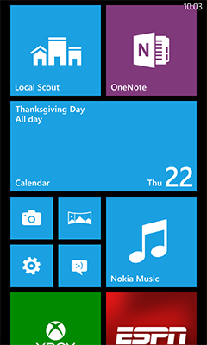
Laptops and Phones
Currently Dell laptops
Don’t generally come with Media Drives
Laptop is encrypted and hard drives / storage cards / keys will have the encryption software
recommend that all key project documentation is uploaded to CGI project share-point sites or client network sites, as appropriate
Currently windows mobile phone on vodaphone network
Worth logging a call with OneIS to get 4G service enabled, its not enabled by default
Worth configuring to get your work related emails on your mobile
Phone has “internet sharing” you can use in combination with your laptop to access CGI network anywhere there is a mobile phone signal – useful.

Slide 13

Software – Standard Software
Your PC will come with the standard office professional suite
Word
Access
Excel
Power-point
Publisher
One-Note
Outlook
Other software needs need to be discussed with your line manager and ordered if required
Project
Visio
Internet Explorer is the standard browser within CGI. A lot of our tools are web-based and you should use Internet Explorer with them
Notes:
Animation – highlights the topic we are about to discuss

Slide 14
Software – Other Software Utilities
Software can be self-installed on your machine in very specific circumstances only
CGI has a mechanism for checking that “free” software does not have any commercial exposure for CGI, members fill in a software approval request (SAR)
A site is provided where “free” software is described as either approved or not approved for use.
Check it before installing anything and periodically re-check if you have added additional software.
Link for more information:
http://ws2.ent.cgi.com/sites/012971/SAR/Lists/ApprovedNonApproved%20SW/AllItems.aspx
Notes:
Animation – highlights the topic we are about to discuss

Slide 15
Software - Microsoft Home Use Programme
As part of CGI’s Enterprise Subscription License (ESL) agreement with Microsoft, CGI members are eligible to participate in the Home Use Program (HUP). This program enables you to get a licensed copy of most Microsoft Office desktop applications to install and use on your home computer with minimal cost.
You may only use software which you have installed on your work PC
You may only use the software whilst you are a CGI employee
Links for more information:
http://portal.ent.cgi.com/ab/func/IS/org/us/Pages/Microsoft-home-use-program.aspx
http://hup.microsoft.com/

Slide 16
Topics
About CGI
Laptops and Phones
Software
Break and Tour Office
Timesheets
Expenses & Travel
Book Desks and Rooms
Remote Working
E-learning and Skillport
Social Media
Holidays & Sick Leave
Flexible Benefits
Break
Dress Code
Resource Management
Wrap-Up

Slide 17

Office Tour
Bureau

Slide 18
Topics
About CGI
Laptops and Phones
Software
Break and Tour Office
Timesheets
Expenses & Travel
Book Desks and Rooms
Remote Working
E-learning and Skillport
Social Media
Holidays & Sick Leave
Flexible Benefits
Break
Dress Code
Resource Management
Wrap-Up

Slide 19
Timesheets
CGI requires you to report how you spent your time on a weekly basis
Fines are imposed on your business unit if you submit your timesheet late.
If you are late, your cgi.com email address is disabled until you submit your time report.
Tardiness in timesheet submission is a factor considered in performance management
Submission deadline is Saturday. On Friday you will start to get reminder emails if you haven’t done a timesheet
Recommendation – try and avoid doing your timesheet on a Friday afternoon as system is at is slowest at that time.

Slide 20
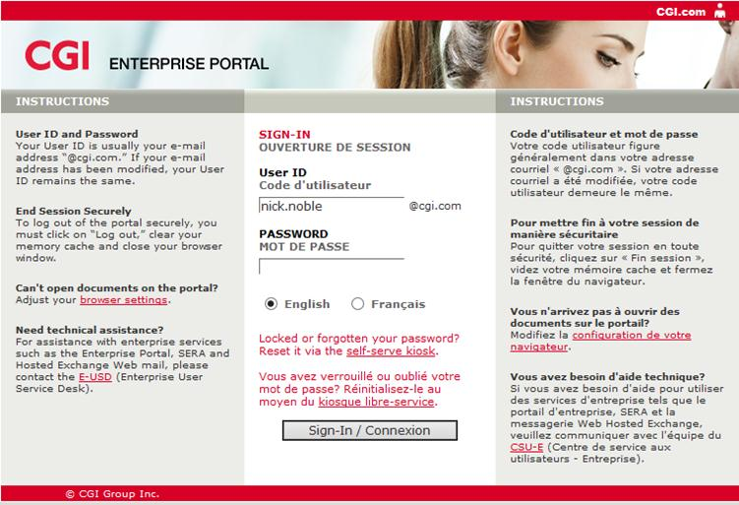
Walkthrough - Timesheets
Part of the Applications Hub
http://portal.ent.cginet:7540/psp/paprd/?cmd=login
This is the lauching page for many important CGI applications

Slide 21
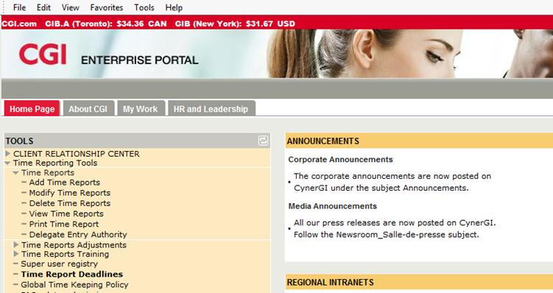
Walkthrough - Timesheets
Timesheet functions are located in an expandable menu on the left

Slide 22
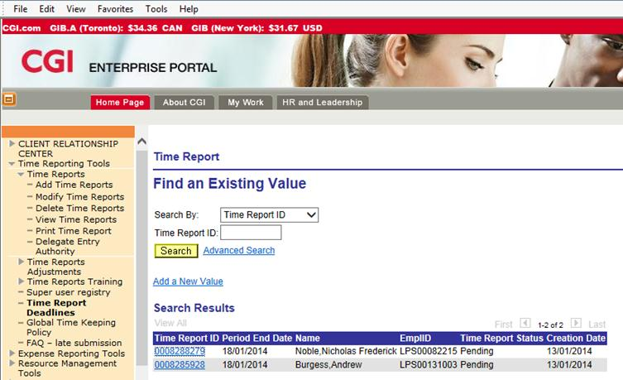
Walkthrough - Timesheets
Select View Time Reports then
Use this interface to search for existing time reports
Notes:
Robin/Mike

Slide 23
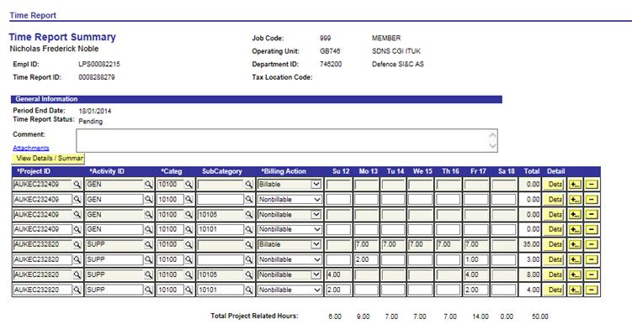
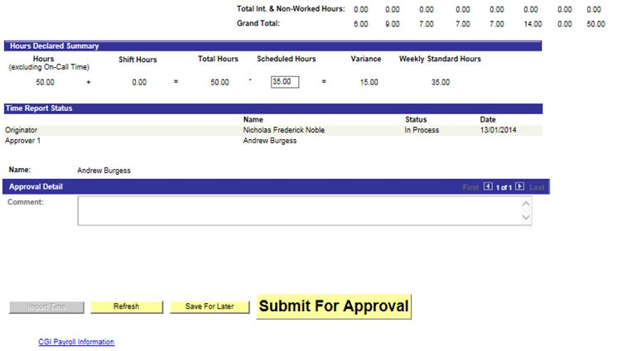
Walkthrough - Timesheets
After you have entered your time scroll down to check that all hours are accounted for…
…then press the submit
For approval button
Notes:
Robin/Mike

Slide 24

Demonstration - Timesheets

Slide 25
Topics
About CGI
Laptops and Phones
Software
Break and Tour Office
Timesheets
Expenses & Travel
Book Desks and Rooms
Remote Working
E-learning and Skillport
Social Media
Holidays & Sick Leave
Flexible Benefits
Break
Dress Code
Resource Management
Wrap-Up

Slide 26
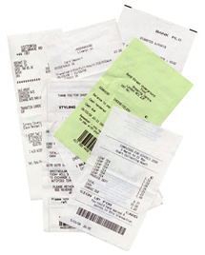
Expenses
UK expenses policy is here:
http://portal.ent.cgi.com/ab/func/res/org/uk/travel/Pages/Manage-Travel.aspx
Designed to cover your out of pocket expenses, mostly when travelling away from your usual base office.
Expense claims need to be verified with a VAT receipt as proof of the expense
Once submitted and approved, payment of expenses is normally quite fast, direct into your bank account.

Slide 27
Expenses
Your normal travel expenses from your home to your designated office are to be deducted from any exceptional travel you do
You only get to claim the remainder
If it is cheaper to travel to your project location than your designated office, you don’t get to claim anything.

Slide 28
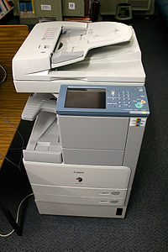
Walkthrough - Expenses
Firstly, scan all your receipts
CGI sites have a scan to email function built into printers.
If you have emails evidencing you were asked to purchase something on expenses or electronic receipts (common in plane flights) its helpful to print to PDF and attach these.
Recommendation – try and avoid doing your expense on a Friday afternoon as system is at is slowest at that time.

Slide 29
Walkthrough - Expenses
Part of the Applications Hub
http://portal.ent.cginet:7540/psp/paprd/?cmd=login

Slide 30
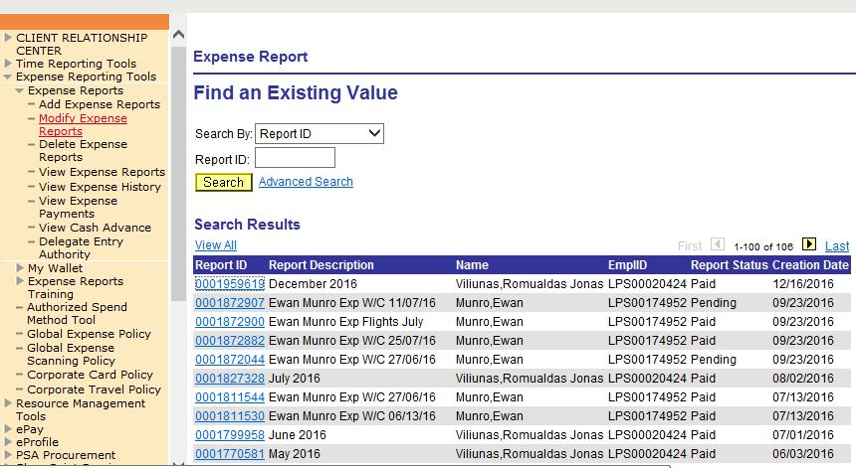
Walkthrough - Expenses
Expense Reporting tools are located here
Select View Expense reports then
Use this interface to search for existing expense reprts

Slide 31
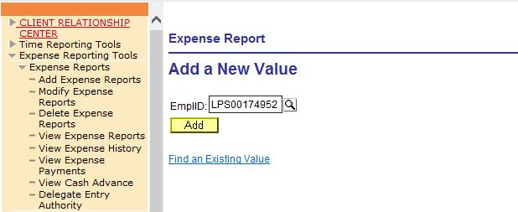
Walkthrough - Expenses
Creating a new expense report begins with this dialog

Slide 32
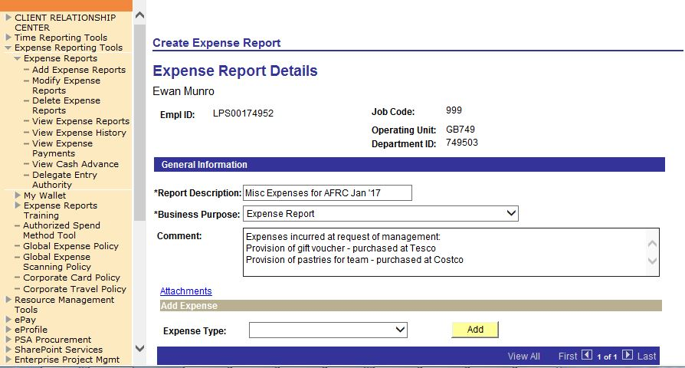
Walkthrough - Expenses
Fill in an
Overview page…
Then use this dialog to add each expense item
to the report

Slide 33
Demonstration - Expenses

Slide 34

Travel
CGI Travel policies are here:
http://portal.ent.cgi.com/ab/func/res/org/uk/travel/Pages/Manage-Travel.aspx
Flights and expensive train tickets & hotels need to be booked through CGIs nominated travel agency, HRG - there is a dedicated portal, you need to set yourself up with an account.
http://portal.ent.cgi.com/lib/bs/comms/uk/travel/Getting%20Started%20with%20HRG%20UK.pdf

Slide 35
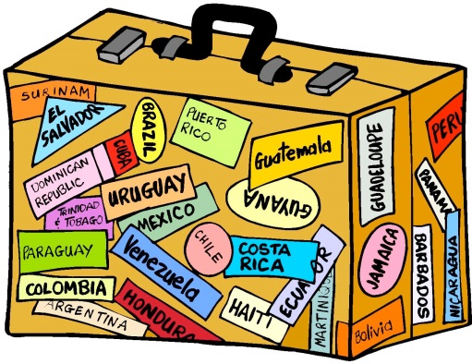
Travel
Travel must be paid for by yourself and then claimed back via the expenses system. A CGI corporate credit card – Mastercard - is recommended, but not mandatory.
http://portal.ent.cgi.com/ab/func/fin/org/UK/Pages/Bank-of-America-Corporate-Card.aspx
There is a cap on the nightly rate for a hotel stay. It varies by city (so “city cap”). If the city is busy and hotels are hard to find, the cap can be exceeded, but only if you book with a preferred hotel.
Evening Meals – maximum £30 per night including drinks

Slide 36
Travel
Travel policy is such that most long distance or overnight trips will require financial approval.
Approval is not always immediately given, usually in a day or so.
If booking a low-cost airline where the price of tickets fluctuate a lot, it may be easier to arrange travel by phoning the travel agency as an approval budget can be agreed and then acted on by the agent.
Hog Robison Group Telephone Number
0843-178-7914

Slide 37
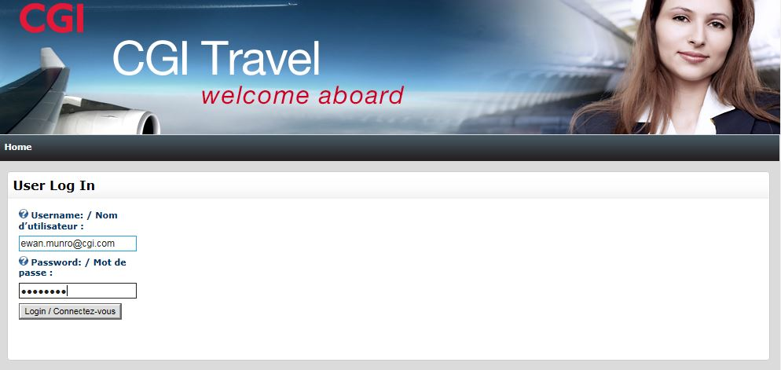
Walkthrough - Travel
Link to Travel Agency Site:
https://isuite2.hrgworldwide.com/cgi/Home/

Slide 38
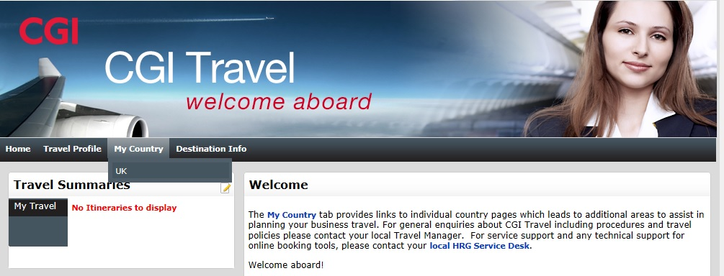
Walkthrough - Travel
Select your country in the following screen

Slide 39
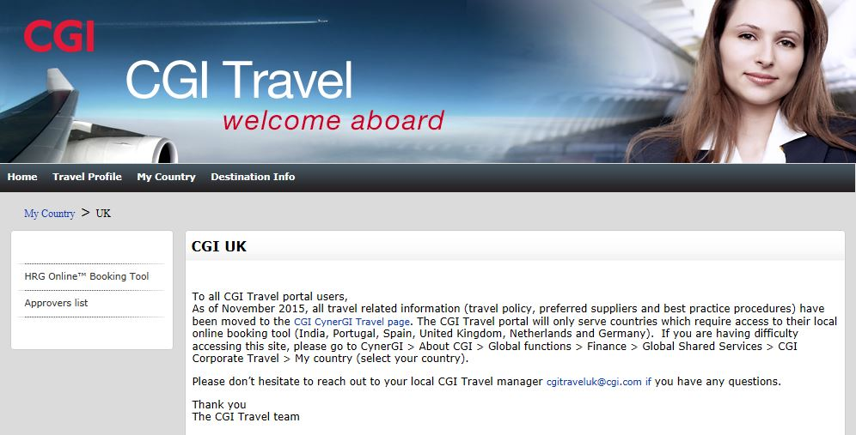
Walkthrough - Travel
This option lets you record general information like passport number and seating preferences
This option allows you to book travel

Slide 40
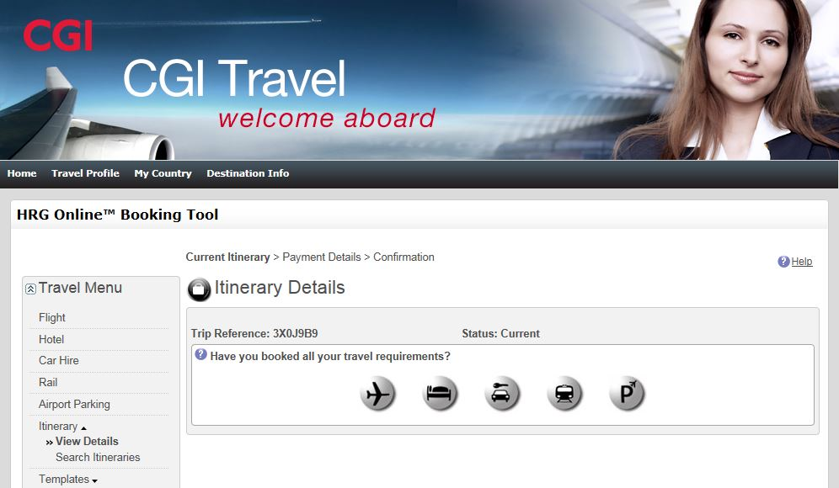
Walkthrough - Travel

Slide 41
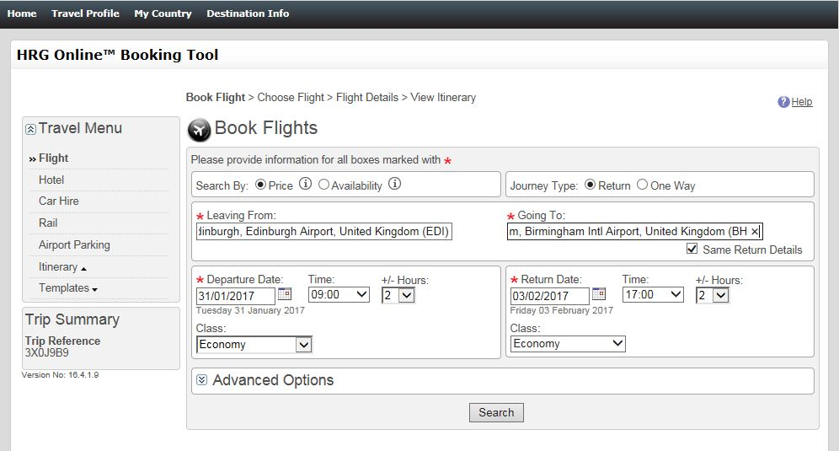
Walkthrough - Travel
Enter your timing preferences then press search
This interface allows you to look for flights

Slide 42
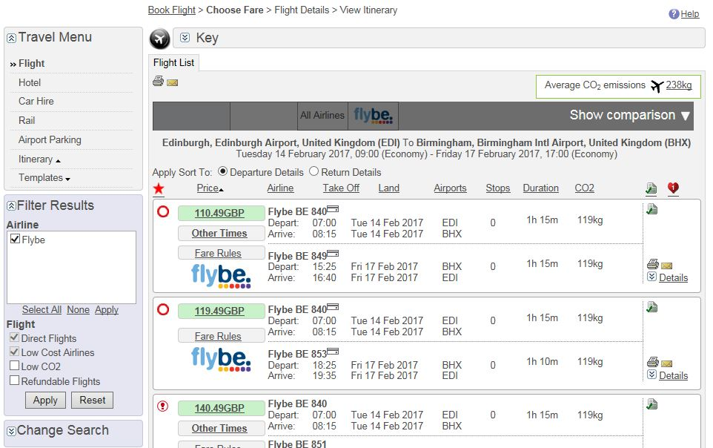
Walkthrough - Travel
Use this screen
to select a flight

Slide 43
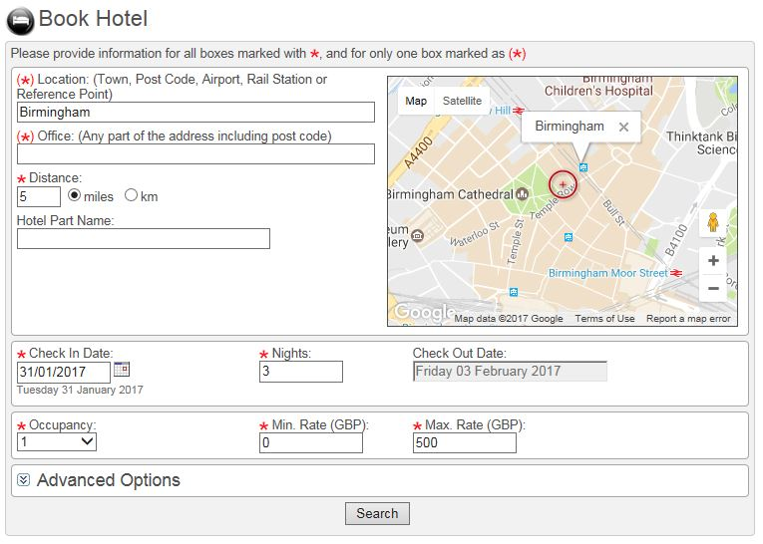
Walkthrough - Travel
A similar interface exists to book hotels
If you’ve booked a flight as part of the same trip your nights stay will be assumed

Slide 44
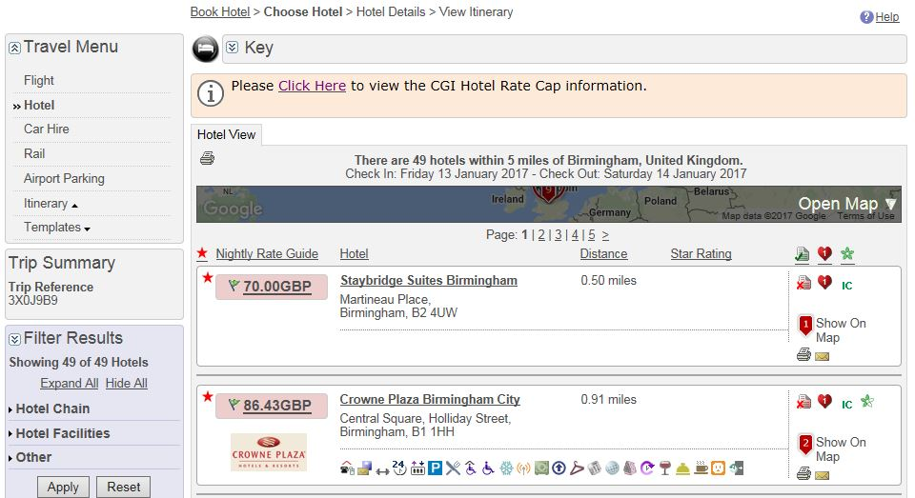
Walkthrough - Travel
The system understands and will try to enforce CGI travel policies
Use this screen
to select an individual hotel room.

Slide 45
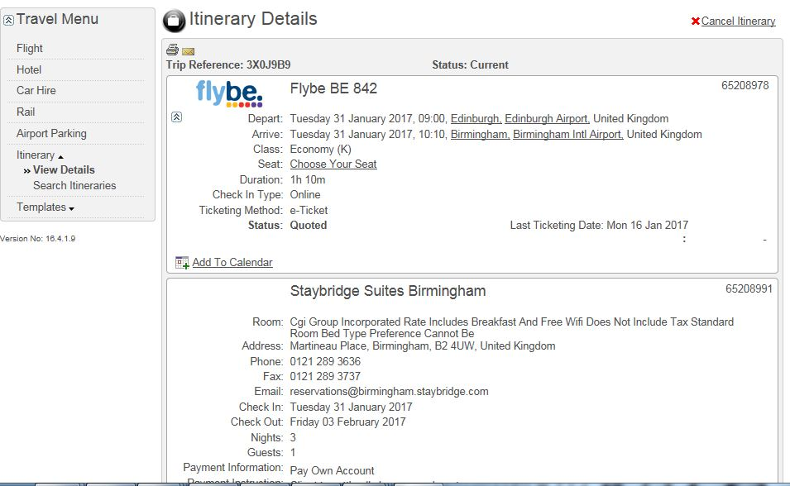
Walkthrough - Travel
At the bottom of the itinerary there is a button to finalize it…
You are then taken to a screen to confirm payment

Slide 46
Demonstration - Travel

Slide 47
Topics
About CGI
Laptops and Phones
Software
Break and Tour Office
Timesheets
Expenses & Travel
Book Desks and Rooms
Remote Working
E-learning and Skillport
Social Media
Holidays & Sick Leave
Flexible Benefits
Break
Dress Code
Resource Management
Wrap-Up

Slide 48
Desk and Room Booking
CGI offices run on a hot-desking principle. You can sit where you like (preferably) within designated project areas but you must book a desk.
More essential at CGI’s busiest offices where desk space is short
Most CGI offices use an online tool called DARBE
If you need to organise a team or client meeting you are allowed to book a room within a CGI offices. In some cases you can do this in DARBE, in some offices you go through reception desk
Meeting rooms generally have a projector and a teleconferencing phone

Slide 49
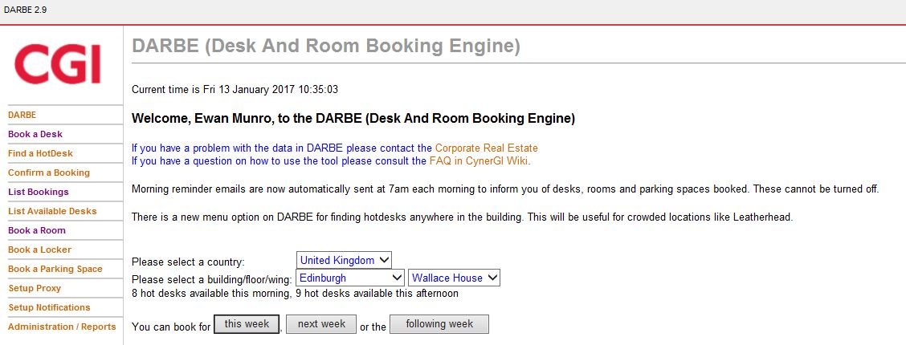
Walkthrough – Desk and Room Booking
Select the office
You want to book at
And a booking option
http://resourcebooking.global.logica.com/hotdesk/cgi-bin/hotdesk-welcome.pl

Slide 50
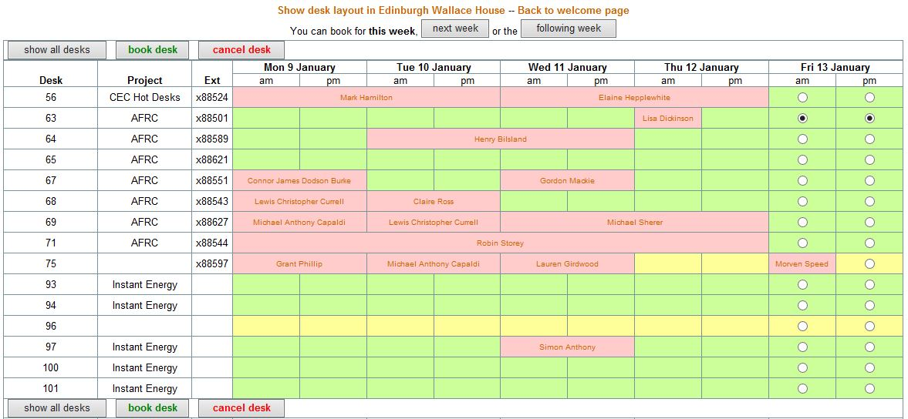
Walkthrough – Desk and Room Booking
Book a free desk by selecting radio buttons. Desks are booked AM / PM
Confirm your booking
Booked desks appear in red with a name

Slide 51
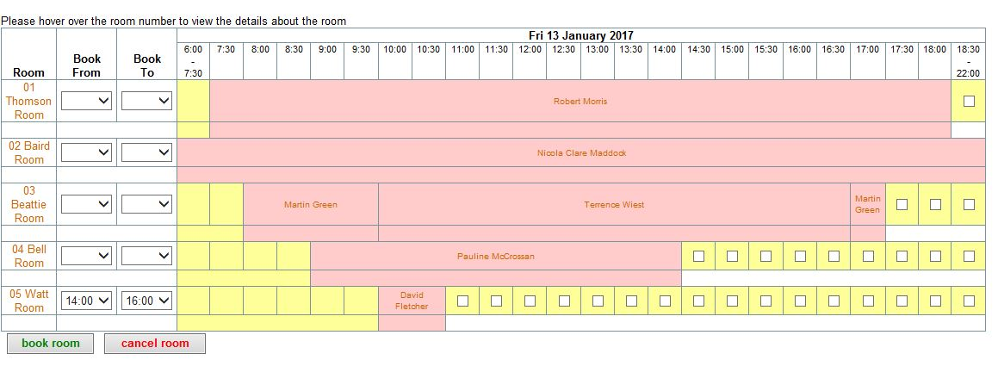
Walkthrough – Desk and Room Booking
…but you can book them to ½ hr intervals
Room bookings display similarly
…or entering a
Time interval
…by either selecting checkboxes…
…the press the book room
button

Slide 52
Walkthrough – Desk and Room Booking
Once you have booked a room or desk, the interface changes colour to show a booking. You do not see your own name on the DARBE interface.
DARBE emails you with the bookings you have made sucessfully.

Slide 53
Demonstration – Desk and Room Booking

Slide 54
Topics
About CGI
Laptops and Phones
Software
Break and Tour Office
Timesheets
Expenses & Travel
Book Desks and Rooms
Remote Working
E-learning and Skillport
Social Media
Holidays & Sick Leave
Flexible Benefits
Break
Dress Code
Resource Management
Wrap-Up

Slide 55
Walkthrough – Remote Working
You may find yourself on a client site where the internal CGI network doesn’t exist
You will need to install Network Connect software which is our Virtual Private Network (VPN) software
You will need to install Entrust IdentityGuard software to authenticate yourself to the network
A Skype account is very useful when collaborating with colleagues
The same technology also permits home working, where circumstances permit it.

Slide 56
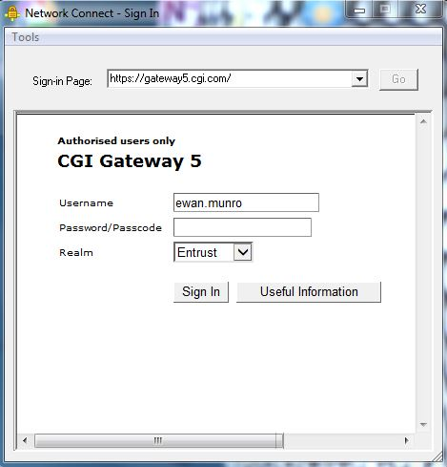
Walkthrough – Remote Working
There are a number of valid
gateway addresses. Switch between them when
There is network congestion
Network
Connect opens up a web-page like interface

Slide 57
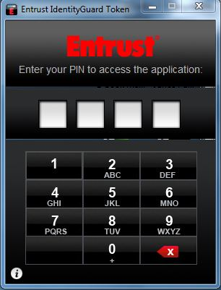
Walkthrough – Remote Working
The entrust software will prompt you to enter a 4 digit PIN

Slide 58
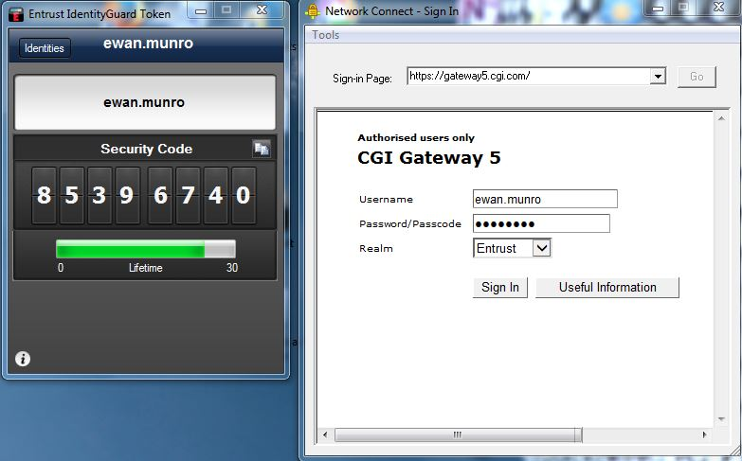
Walkthrough – Remote Working
Use this button to copy your security code to clipboard
Entrust generates a security code
Paste the code here
which changes every 30 secs

Slide 59
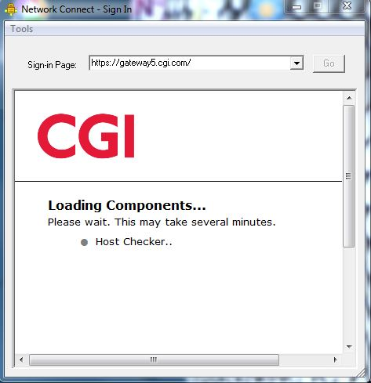
Walkthrough – Remote Working
You will see this message displayed for several minutes

Slide 60
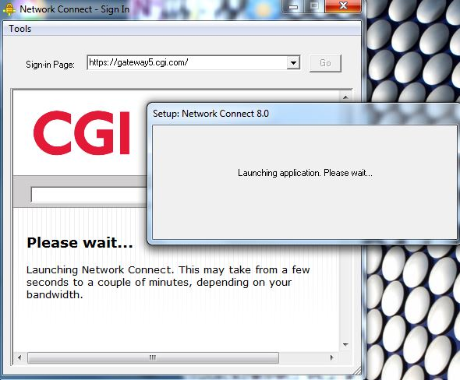
Walkthrough – Remote Working
Followed by this one showing Network Connect is connecting

Slide 61
Walkthrough – Remote Working
When the process completes the Network Connect will minimize to your taskbar at the bottom right
You will be able to launch outlook, internet explorer and skype and have them connect to the corporate GROUPINFRA network

Slide 62
Demonstration – Remote Working

Slide 63
Topics
About CGI
Laptops and Phones
Software
Break and Tour Office
Timesheets
Expenses & Travel
Book Desks and Rooms
Remote Working
E-learning and Skillport
Social Media
Holidays & Sick Leave
Flexible Benefits
Break
Dress Code
Resource Management
Wrap-Up

Slide 64
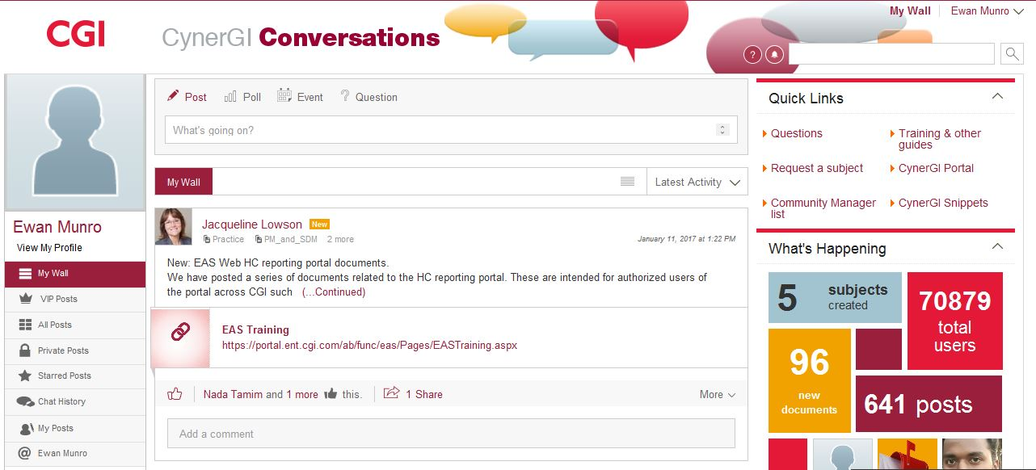
Walkthrough – Cynergi / Social Network

Slide 65
Demonstration – Cynergi / Social Network

Slide 66
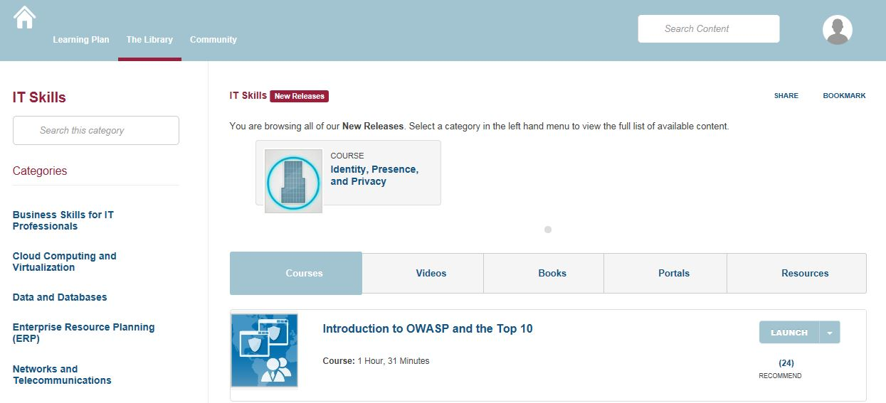
Walkthrough – Learning Portal

Slide 67
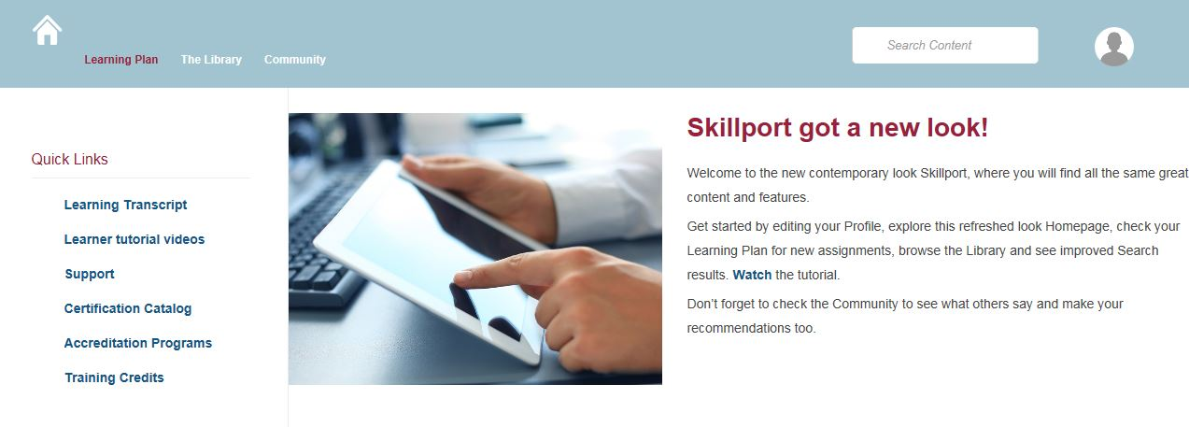
Walkthrough – Learning Portal
Link is:
https://cgi.skillport.com/skillportfe/custom/login/cgi/login.action

Slide 68
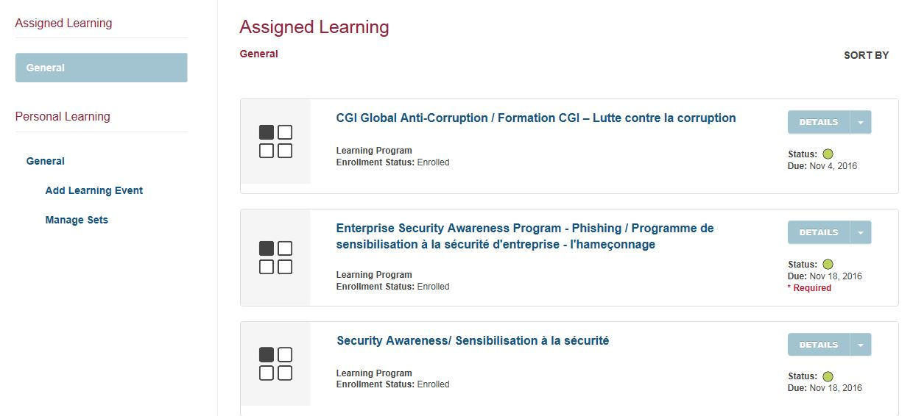
Walkthrough – Learning Portal
You will have been assigned mandatory e-learning training which you must complete…
…topics include anti-corruption and security awareness

Slide 69
Demonstration – Learning Portal

Slide 70
Topics
About CGI
Laptops and Phones
Software
Break and Tour Office
Timesheets
Expenses & Travel
Book Desks and Rooms
Remote Working
E-learning and Skillport
Social Media
Holidays & Sick Leave
Flexible Benefits
Break
Dress Code
Resource Management
Wrap-Up

Slide 71

Lunch Break

Slide 72
Topics
About CGI
Laptops and Phones
Software
Break and Tour Office
Timesheets
Expenses & Travel
Book Desks and Rooms
Remote Working
E-learning and Skillport
Social Media
Holidays & Sick Leave
Flexible Benefits
Break
Dress Code
Resource Management
Wrap-Up

Slide 73
Holidays 1/2
CGI’s Annual Leave policy for the UK is here:
http://portal.ent.cgi.com/lib/bs/hr/uk/cb/GBR_HR_Annual_Leave_Public_Holidays_Policy.pdf
You get a holiday allowance that accrues each month according to the days you’ve worked.
You are expected to save 3 of your annual leave days for the period between Xmas and New Year
At the end of the calendar year the holiday balance is reset
if you haven’t taken your holiday entitlement you lose it,
In exception circumstances the company may grant permission to carry over no more than 5 days, by no more than 3 months.

Slide 74

Holidays 2/2
Let both your line manager and career mentor know your are taking leave in plenty of time
Book your leave through the PSA HR Service Center (HRSC)
Don’t book your holiday travel unless your holiday is approved
Scotland local holiday rules:
Scotland members have some public holiday days translated into annual leave so Scotish members do not have to adhere to English public holidays, except Xmas Day, Boxing Day and New Years Day which are mandatory. In short, you don’t have any more holiday entitlement than English colleagues, but you do have more flexibility.

Slide 75
Sick Leave
CGI’s Absence Management Policy is here:
http://portal.ent.cgi.com/lib/bs/hr/uk/cb/GBR_HR_Sickness_Absence_Policy.pdf
Some rules of thumb:
Let your manager know by phone, before 09:30 if you are off-sick
Record your absence in PSA HRSC
After 7 days you need a doctors note
After a set number of instances of sick leave in a given period a review can be triggered.
For short absences, such as GP appointments, it suggested they are taken and worked off “in-lieu”

Slide 76
Topics
About CGI
Laptops and Phones
Software
Break and Tour Office
Timesheets
Expenses & Travel
Book Desks and Rooms
Remote Working
E-learning and Skillport
Social Media
Holidays & Sick Leave
Flexible Benefits
Break
Dress Code
Resource Management
Wrap-Up

Slide 77
Flexible benefits 1/3
CGI’s benefits package has some flexibility.
You will be invited to specify some preferences not long after joining and then annually, just before the end of the calendar year.
Most benefits are services for sacrifice of salary. The are a simple way of purchase services such as dental cover or travel insurance
Important ones that are not are
Contributory Pension – if you put money in, so does CGI
Share Purchase Plan – if you buy shares, so does CGI
Life Insurance

Slide 78
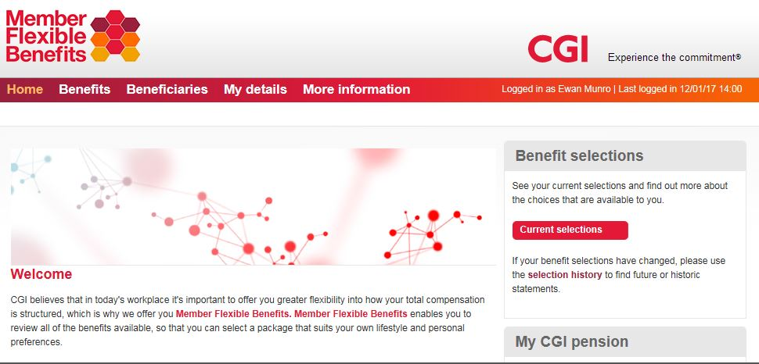
Flexible benefits 2/3
One enrolled you can review your selected benefits here:
Member Flexible Benefits
Review your selections here

Slide 79
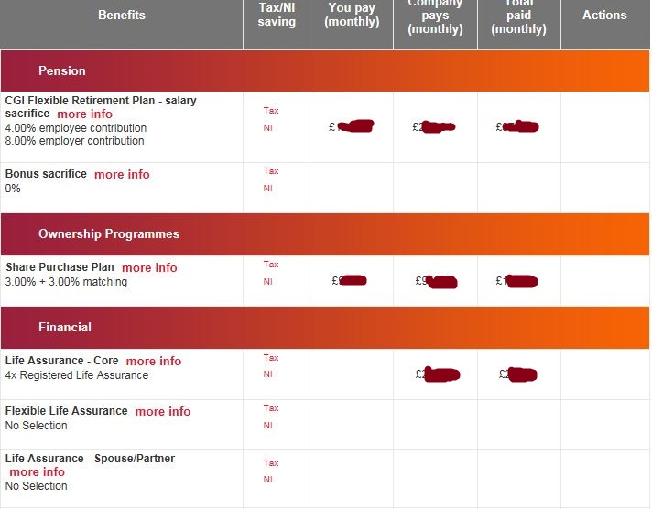
Flexible benefits 3/3

Slide 80
Topics
About CGI
Laptops and Phones
Software
Break and Tour Office
Timesheets
Expenses & Travel
Book Desks and Rooms
Remote Working
E-learning and Skillport
Social Media
Holidays & Sick Leave
Flexible Benefits
Break
Dress Code
Resource Management
Wrap-Up

Slide 81

Time for a Break ?

Slide 82
Topics
About CGI
Laptops and Phones
Software
Break and Tour Office
Timesheets
Expenses & Travel
Book Desks and Rooms
Remote Working
E-learning and Skillport
Social Media
Holidays & Sick Leave
Flexible Benefits
Break
Dress Code
Resource Management
Wrap-Up

Slide 83

Dress Code
CGI’s Dress code policy is here:
http://portal.ent.cgi.com/lib/bs/hr/global/cme/CGI_HR_Dress_Code_Policy.pdf
Some rules of thumb:
Dress as smart or smarter than the client
When in doubt, stay on the conservative side, always look professional and never wear clothes that are designed for leisure.

Slide 84
Walkthrough – Resource Management
Part of the Applications Hub
http://portal.ent.cginet:7540/psp/paprd/?cmd=login

Slide 85
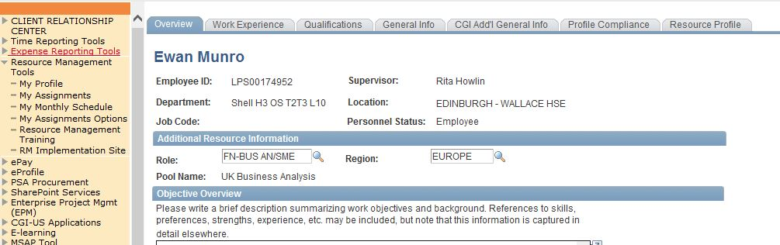
Walkthrough – Resource Management

Slide 86
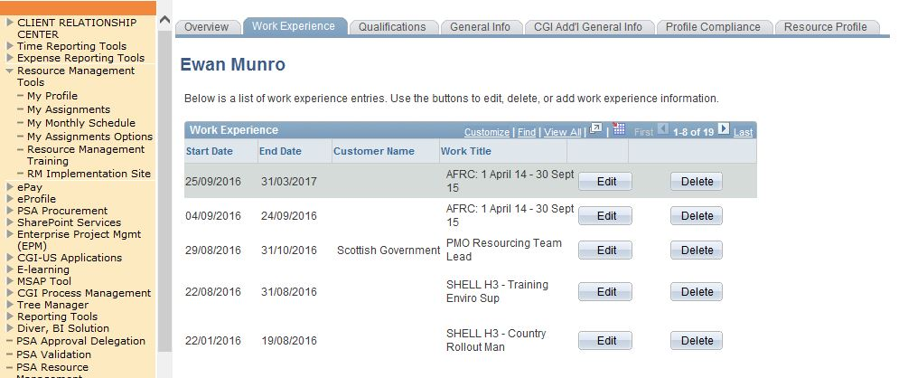
Walkthrough – Resource Management
The tool contains your work history. This is built automatically on the basis of the projects you booked time to

Slide 87
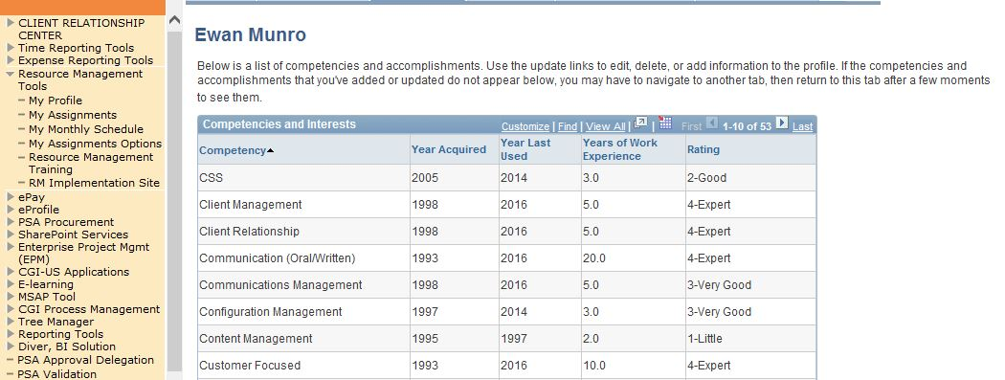
Walkthrough – Resource Management
Select skillsets and interests and report your level of expertize

Slide 88
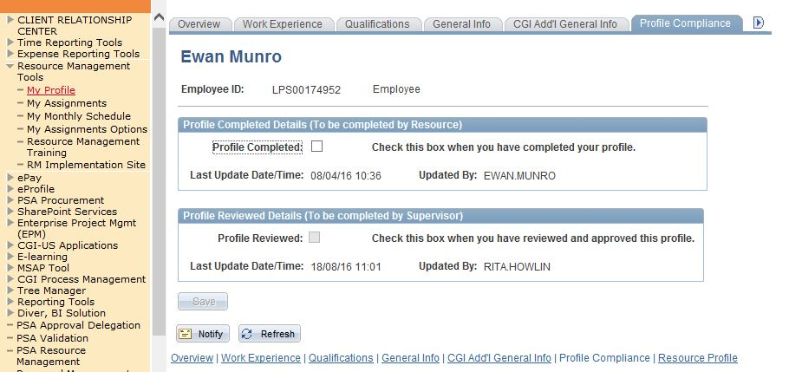
Walkthrough – Resource Management
Your profile needs to be approved by your manager before it is published.

Slide 89
Demonstration – Resource Management

Slide 90
Resource Management - Between Assignments
CGI’s Assignment and Transfer policy is here:
http://portal.ent.cgi.com/lib/bs/hr/uk/cme/GBR_HR_Assignment_Transfer_Policy.pdf
CGI’s is a company that supplies services and people to clients. As clients needs change over time it is to be expected that assignments will change an end. Members that find themselves between assignments are also described as being “on the bench”
You will have a utilization target (percentage of chargeable versus non-chargeable time)
If you are between assignments you are expected to devote your time to looking for a new role.
Members transfer between business units periodically in response to long-term assignments and shifts in client demands.
Useful Links:

Slide 91
Topics
About CGI
Laptops and Phones
Software
Break and Tour Office
Timesheets
Expenses & Travel
Book Desks and Rooms
Remote Working
E-learning and Skillport
Social Media
Holidays & Sick Leave
Flexible Benefits
Break
Dress Code
Resource Management
Wrap-Up

Slide 92
Wrap Up – last few mentions
Business Cards
Mostly not used in the organisation unless in sales facing roles
http://portal.ent.cgi.com/ab/func/comms/org/uk/Pages/UK-Business-Cards.aspx
Sports and Social Club
Sponsors events that members (and partners) can participate in
http://portal.ent.cgi.com/ab/func/hr/org/uk/cme/sc/Pages/default.aspx
Member ReCoGnItion Scheme
http://portal.ent.cgi.com/ab/func/hr/org/uk/cme/rp/Pages/mrs.aspx
Member Council
Elected council for conveying common member concerns
http://portal.ent.cgi.com/latest/news/uk/Pages/members-council.aspx

Slide 93

Any Last Questions ?

Slide 94
Our commitment to you We approach every engagement with one objective in mind: to help clients succeed

